Slide 1

JNANAVIKAS INSTITUTE OF TECHNOLOGY (Affiliated to Visvesvaraya Technological University, Belagavi, Approved by AICTE, New Delhi) ​
DEPARTMENT OF COMPUTER SCIENCE
TOPIC : Automated Invigilation System for Detection of Suspicious Activities during Examination
Presented by,
Anjali R (1JV19CS003)
Nandan (1JV19CS015) Under Guidance of,
Navya S K (1JV19CS016) NOOR SUMAIYA
Priya N (1JV19CS019) Assistant Professor
Department of computer science

Slide 2
CONTENTS
INTRODUCTION
ABSTRACT
LITRATURE SURVEY
BLOCK DIAGRAM
DESIGN
IMPLEMENTATION
EXISTING SYSTEM
PROPOSED SYSTEM
SYSTEM REQUIREMENTS
SUMMARY

Slide 3
ABSTRACT
Supervising students which helps student to be positive, help create a more supportive caring and positive working environment. Mostly supervisor cannot concentrate in all the students in a particular time during exam invigilation.
Cheating and abnormal activities like- whispering, using mobile phone, impersonation or hand contact are widely involved in offline examination around the globe are very common. This creates situation for student to make integrity and moralities.
The artificial supervising robot will monitor students suspicious activities and sends signals through Wi-Fi (Node MCU) and this will also gives an buzzer alter when students are trying to cheat in examination and in LCD display it shows how many students are copying.
The main purpose of this Artificial supervisor Ai based algorithm will be more active on students so students cannot cheat on exam duration also an supervisor can also find student who tried to copy during the examination.

Slide 4
Introduction
According to Dr. Donald McCabe's and International Center for Academic Integrity survey and research, which reports that about 68% of undergraduate students admit to cheating in written tests.
In state of India (Bihar) alone in February 2018, 1000 students were expelled from examination for cheating.
The purpose of this algorithm (Artificial supervisor AI based algorithm) is to monitor the students and analyzing suspicious activities during examination.
Every institution suffers the malpractices in the examination, this model will have a robust face and activities detection algorithm that tracks every students activities in the classroom, including face movement, mouth open etc.

Slide 5
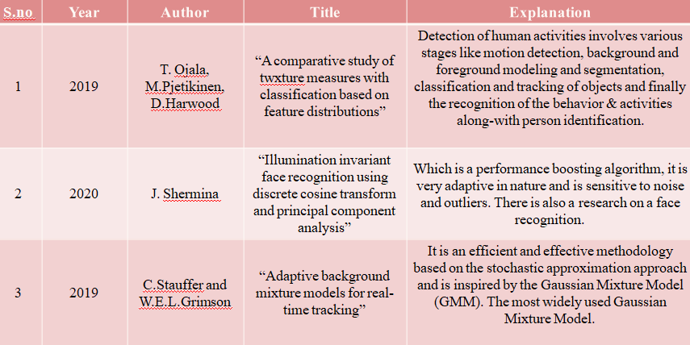
LITRATURE SURVEY

Slide 6
Automated Invigilation System for Detection of Suspicious Activities during Examination
Existing system
Only video camera where been available, which takes lots of time to check on each students.
Human power is need for completion to maintain students
There is no image detection and video monitoring is single system.
The algorithm which was used is very basic level, that requires time cost.
There was only motion detection

Slide 7
DISADVANTAGES
Man power is need, which is difficult to handle everyone at the same situation.
Should have to check on each and every student

Slide 8
10
Automated Invigilation System for Detection of Suspicious Activities during Examination
PROPOSED SYSTEM
Artificial supervising Ai based algorithm which enables the image and video processing.
This video system which enables the process of monitoring the suspicious activities of students, where this system is automated by video and image to monitor students activities during the examination in real-time.
The artificial supervising robot will monitor students suspicious activities and sends signals through Wi-Fi (Raspberry pi) and this will also gives an buzzer alter when students are trying to cheat in examination.
.

Slide 9
Advantages
Automated Invigilation System for Detection of Suspicious Activities during Examination
The Artificial supervisor Ai based algorithm helps to give quality of student. Helps supervisor reduce their work.
Artificial supervisor Ai based algorithm will be more active on students so students cannot cheat on exam duration also an supervisor can also find student who tried to copy during the examination.

Slide 10
HARDWARE REQUIREMENTS
• Node MCU
• SD card class 10.
• 15watts adopter.
• USB camera
• Buzzer indicator.
• Light indicator.

Slide 11
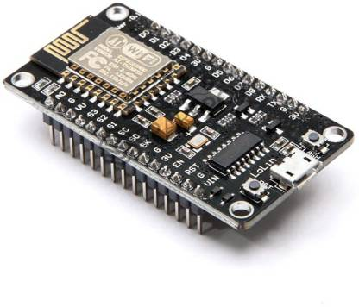
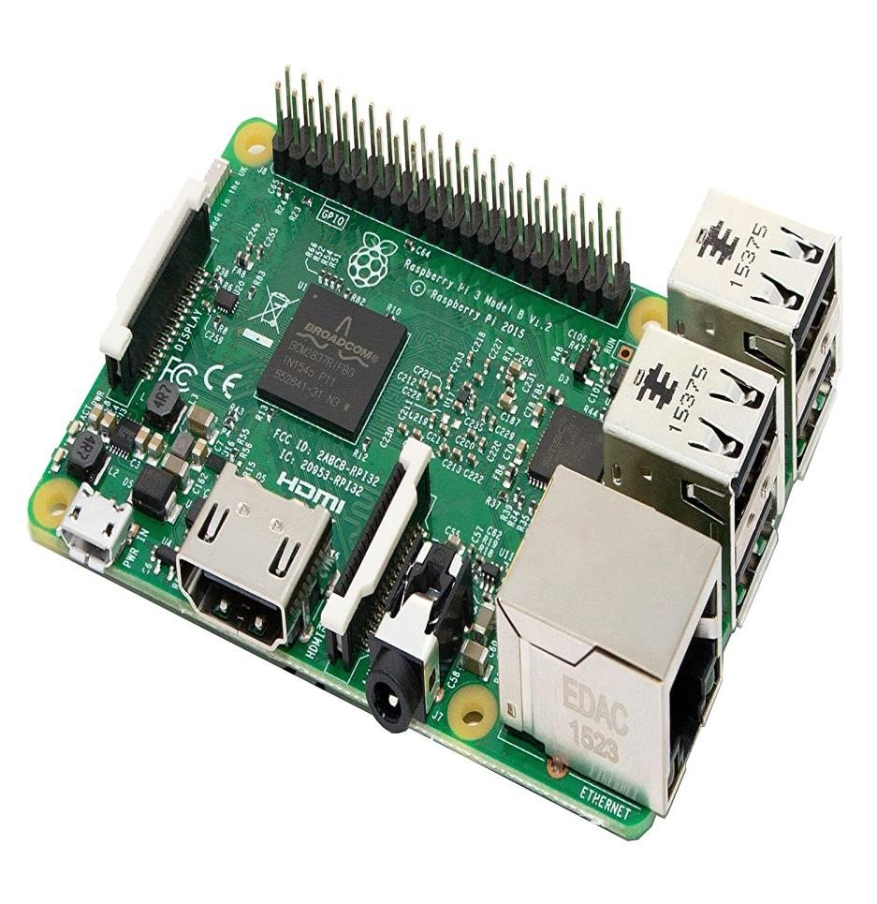
Node MCU- Hardware requirement
Automated Invigilation System for Detection of Suspicious Activities during Examination
The Node MCU (Node Microcontroller Unit) is open source software and hardware development environment that is built around a very inexpensive System-on-a-Chip (SoC) called the ESP 32. The ESP 32, designed and manufactured by Espressif Systems, contains all crucial elements of the modern computer: CPU, RAM, networking (Wi-Fi), and even a modern operating system and SDK

Slide 12
SOFTWARE REQUIREMNTS
python 3.8 above version
• Thonny idle.
• Computer vision library
• yolo algorithm.
• Smtp protocol.

Slide 13
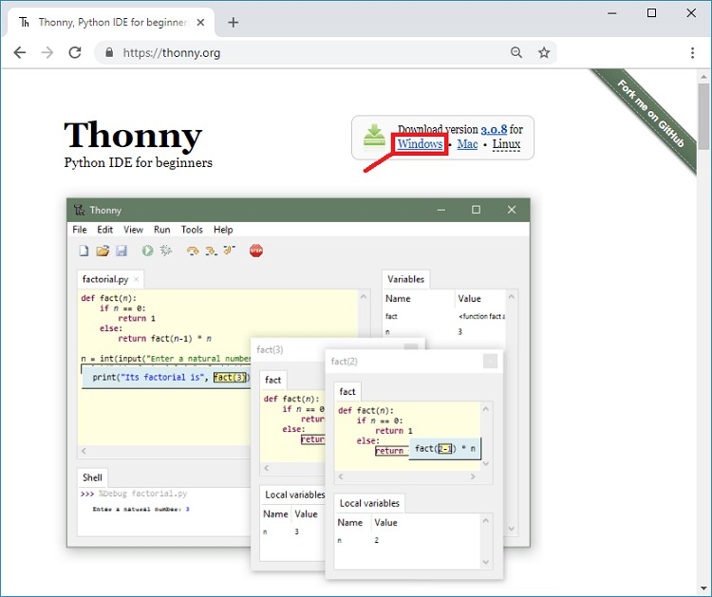
Thonny software
Automated Invigilation System for Detection of Suspicious Activities during Examination
An integrated development environment (IDE) facilitates computer programmers by integrating fundamental tools (e.g., code editor, compiler, and debugger) into a single software package. Users do not need to install the language’s compiler/interpreter on their machines; an IDE provides the environment itself.
Thonny is a free, dedicated IDE for Python designed for beginners.

Slide 14
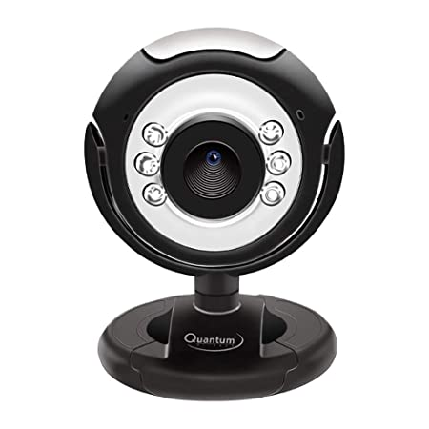
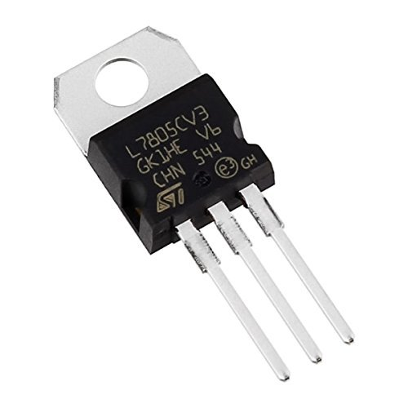
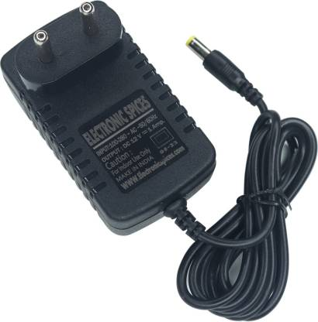
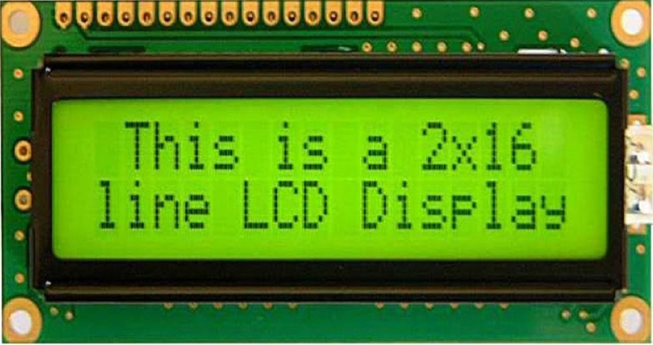
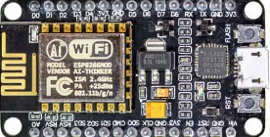
BLOCK DIAGRAM
Frame separation video 25fps
Single frame conversion
Image pre processing and segmentation
Gray scale process
Gaussian filter for Noise removal
Yolo- classifier SDD algorithm
Serial communication
SMTP protocol
Decoder comparator
Training data set images
Connecting to hardware
mail image notification sent to exam officer
Mobile activity matches
authorized or unauthorized person
Contour mapping

Slide 15
Design
This project is designed by using Node MCU and Thonny software, here the input image are trained in database, the input is preprocess here the detection of cheating student in exam hall are detected by using AI based algorithm. Input images and database images are compared with help of AI based algorithm, the images are extracted using key point descriptor.

Slide 16
Implementation
With this project we can bring quality of education, where we can conduct good level of exam and avoid malpractice such kinds of activities in exam hall. Student will understand the quality of education and we can bring out quality of students in every education system. By implementation this project we can develop education

Slide 17
SUMMARY
The proposed model for detection of suspicious activities in classroom during examination is based on various computer vision algorithms. This will allow it successfully implement the system for detection of various activities during a examination. This model helps educational institutions extensively in curbing abnormal or unfair activities in the classroom. The proposed system will definitely give high accuracy and minimizes computational resources. The system model works as the framework to develop and add more activities to detect apart from one mentioned here. The Raspberry pi which is internet connection will send an each and every information with the buzzer alter to the exam cell department.

Slide 18
THANK YOU

